Slide 1
GRIP July 2022 Internship
The Sparks Foundation
Task 3
DOMAIN :
Data Science And Business Analytics
SUBMITTED BY :
GARIMA SHARMA

Slide 2


Hello , I am Alex.
I got Promoted as Business Manager .

Slide 3


First Task assigned to me is to analyse data from our retail costumer .

Slide 4
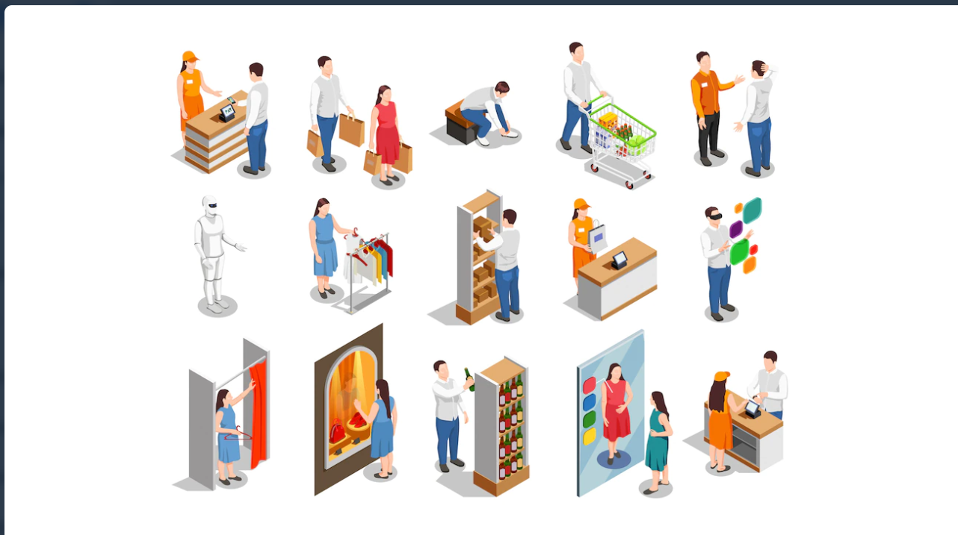

Let`s take a look at data from
day to day activities of the store

Slide 5

The Aim is to identify the weak areas using Power BI and
find the problems in the business through data exploration.
The result should be to increase profit.

Slide 6

Let’s create a Dashboard of Analysis Data using Microsoft Power BI

Slide 7
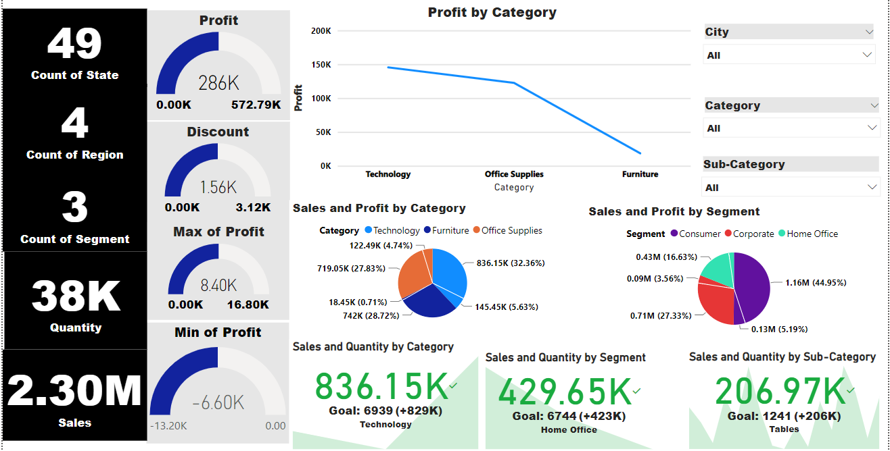
DASH BOARD

Slide 8
Data Exploration
Count of states , region , segment ,quantity and sales.
Profit, minimum and maximum as well as discount.
Sales and Quantity analysis .
Sales and Profit analysis in Category and segment.
City , Category and Subcategory wise analysis.

Slide 9

Conclusion And Take Away From Task 3
1. Making of Dash board using Microsoft power BI.
2. Exploring details of data given.
3. The less quantity supply might be the reason of less profit .

Slide 10

Thank You

